Slide 1
What’s in this Training
Versioning
Version control system (VCS)
Centralized and Distributed version control
GIT Architecture
GIT Workflow
GIT Download/Account setup
Basic linux and GIT Commands
Hands-on

Slide 2
What is versioning?
Versioning is the creation and management of multiple product releases, all of which have the same general function, but are improved, upgraded or customized. While many developers and vendors use the term in different contexts, versioning most often applies to operating systems, software artifacts and web services.

Slide 3
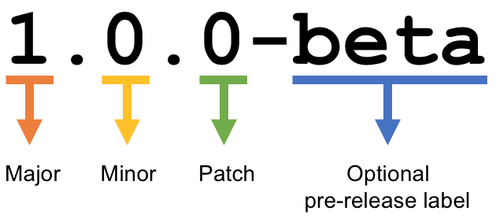
MAJOR version when you make incompatible API changes, MINOR version when you add functionality in a backwards compatible manner, and PATCH version when you make backwards compatible bug fixes. Additional labels for pre-release and build metadata are available as extensions to the MAJOR.MINOR.PATCH format.

Slide 4
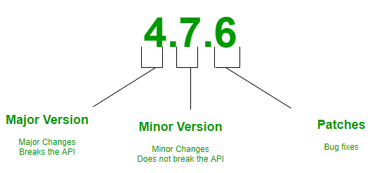
Example Version

Slide 5
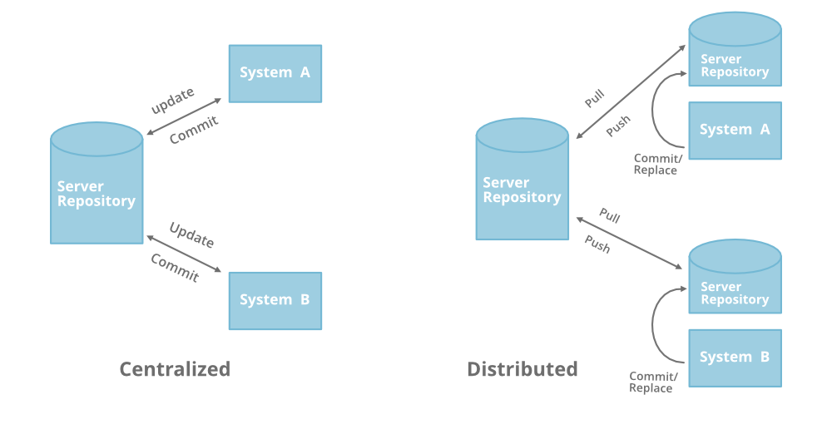
Centralized vs Distributed Version Control: Which One Should We Choose?

Slide 6
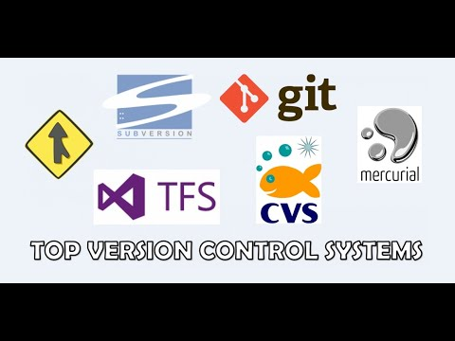

Slide 7
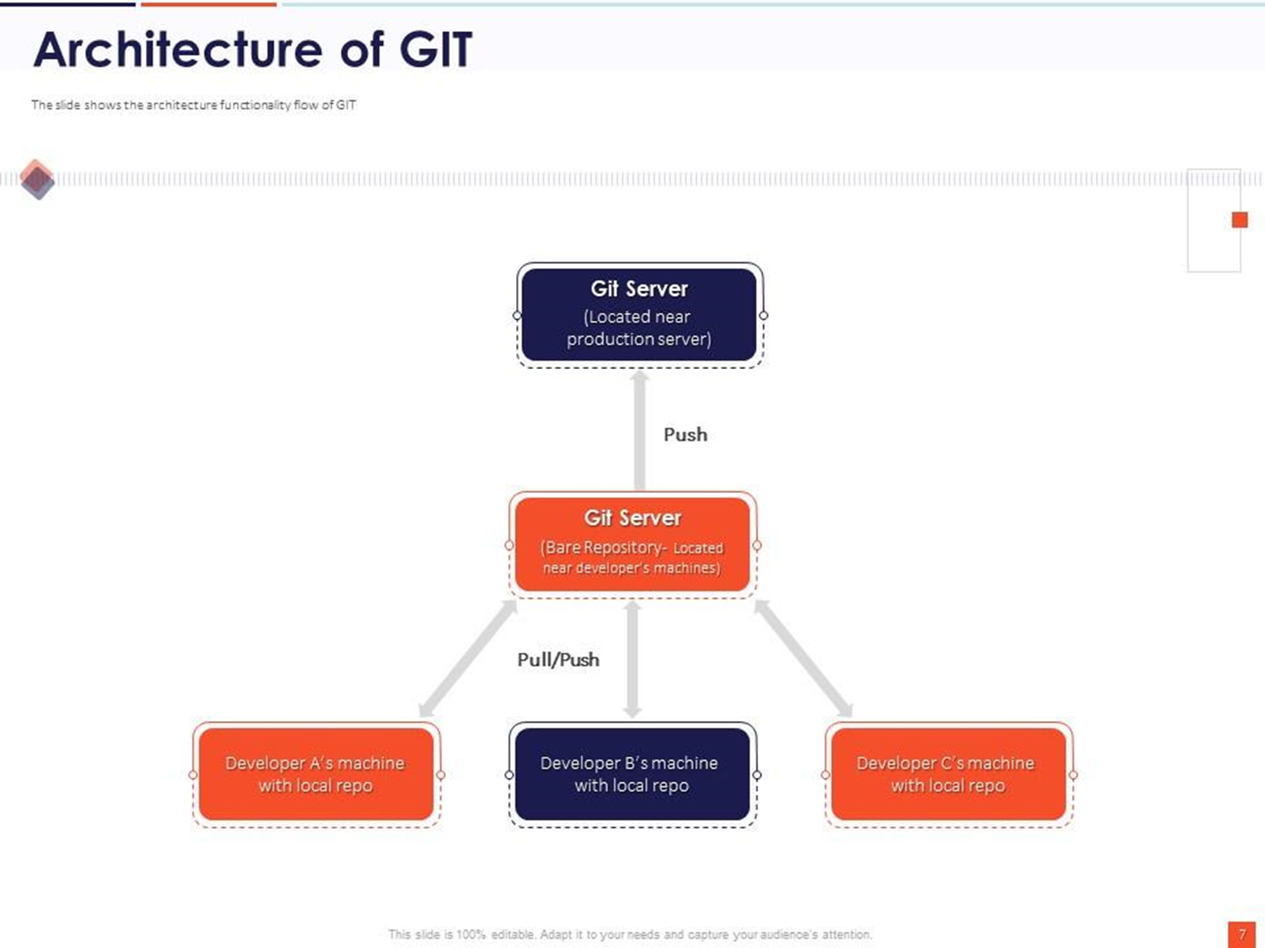

Slide 8
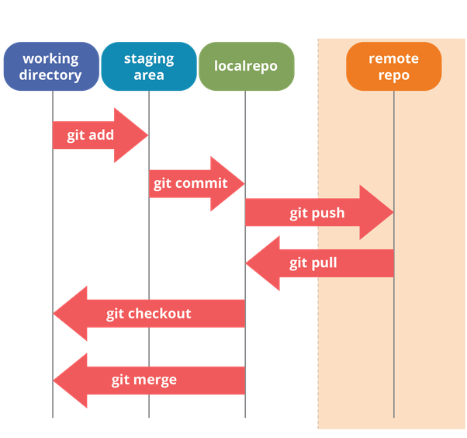

Slide 9
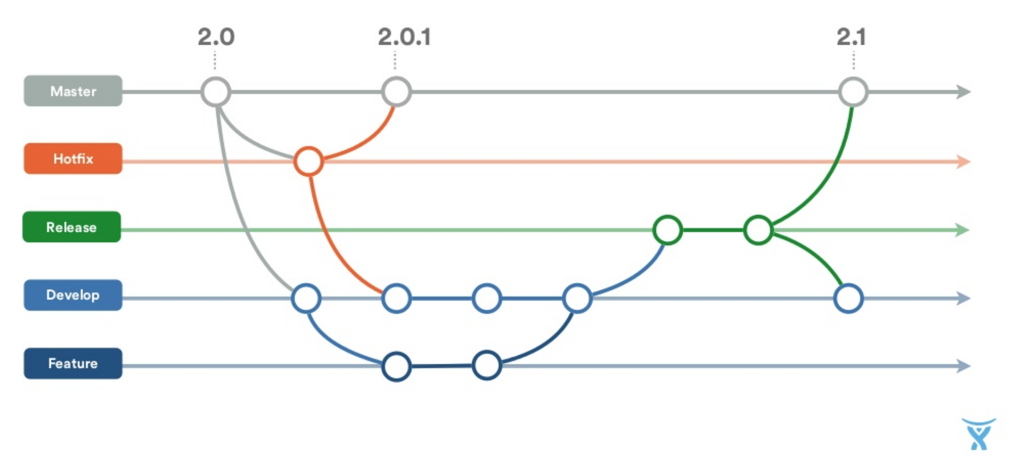
GIT Workflow

Slide 10
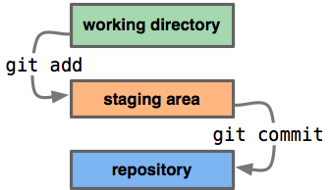
Let us see the basic workflow of Git. Step 1 − You modify a file from the working directory. Step 2 − You add these files to the staging area. Step 3 − You perform commit operation that moves the files from the staging area. After push operation, it stores the changes permanently to the Git repository.

Slide 11
Basic GIT Commands
git --version
git config --global user.name “your usernmae“
git config --global user.email “your email id “
git init
git add <file name>
git commit –m “your message”
git push <remote repo url>

Slide 12
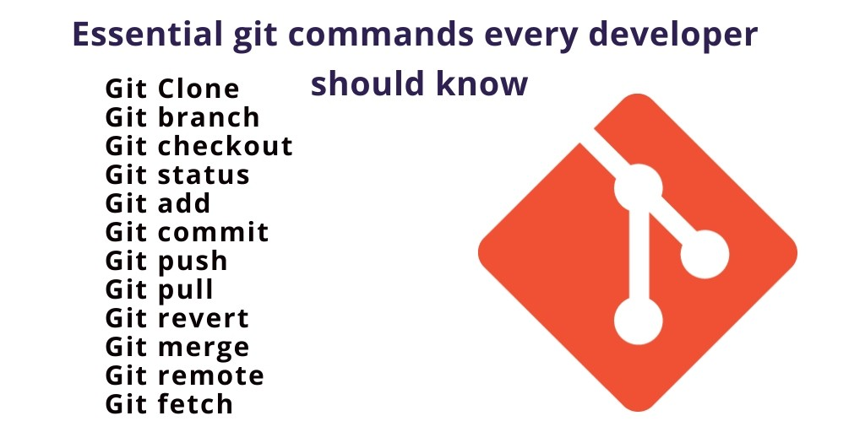

Slide 13
git config
Usage: git config –-global user.name “[name]”
Usage: git config –global user.email “[email address]”
This command sets the author name and email address respectively to be used with your commits.

Slide 14
git init
Usage: git init [repository name]
This command is used to start a new repository.
git clone
Usage: git clone [url]
This command is used to obtain a repository from an existing URL.

Slide 15
git add
Usage: git add [file]
This command adds a file to the staging area.

Slide 16
git commit
Usage: git commit -m “[ Type in the commit message]”
This command records or snapshots the file permanently in the version history.
git push
Usage: git push [variable name] master
This command sends the committed changes of master branch to your remote repository.

Slide 17
git status
Usage: git status
This command lists all the files that have to be committed.
git log
Usage: git log
This command is used to list the version history for the current branch.

Slide 18
GIT branching
git branch
Usage: git branch
This command lists all the local branches in the current repository.
git checkout
Usage: git checkout [branch name]
This command is used to switch from one branch to another.
git checkout -b [branch name]
This command creates a new branch and also switches to it.
git merge (source branch) (target branch)

Slide 19
Usage: git remote add [variable name] [Remote Server Link]
This command is used to connect your local repository to the remote server

Slide 20
git pull
Usage: git pull [Repository Link]
This command fetches and merges changes on the remote server to your working directory.

Slide 21
Git branching
Git branching strategy
Git merge
Git branch create and delete

